Slide 1

Shell Bootcamp 2024 Reflections for Week 2
Rohita Chakraborty
Date : 06-Sep-2024

Slide 2

About Me
Family is our foundation; happiness is our goal!

Slide 3

My learnings from this week!

Slide 4
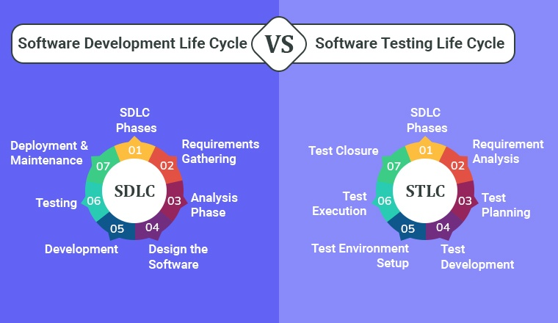
Day 1 - | My takeaways
Topics learnt are:
Software testing
SDLC (Software Development Life Cycle)
STLC (Software Testing Life Cycle)
Unit, Integration, System and Acceptance testing
Testing triangle
Blackbox, Whitebox and Greybox testing
TDD (Test Driven Development)
ATDD (Acceptance Test Driven Development)

Slide 5
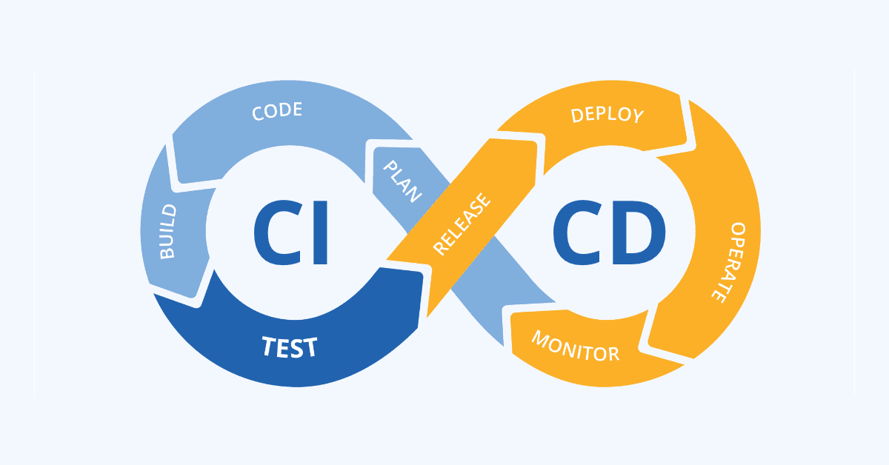
Day 2 | My takeaways
Topics learnt are:
Useability testing
Functional and non-functional testing
Static and dynamic testing
Types of release – major, minor, service pack
Automated testing and its tools
BDD (Behavioral Driven Development)
DDD (Doman Driven Development)
CICD (Continuous Integration, Continuous Deployment)

Slide 6
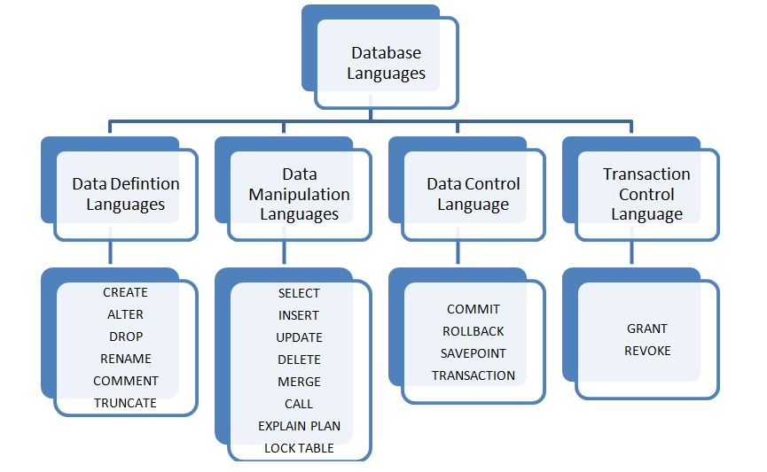
Day 3 | My takeaways
Topics learnt are:
Components of github action – workflow, event, jobs, action, runner
YAML file
Secrets and environment variables
Types of database – relational, object oriented, distributed, data warehouse, nosql, OLTP)
Types of languages – DDL, DQL, DML, DCL, TCL
Code scanning and its benefits

Slide 7
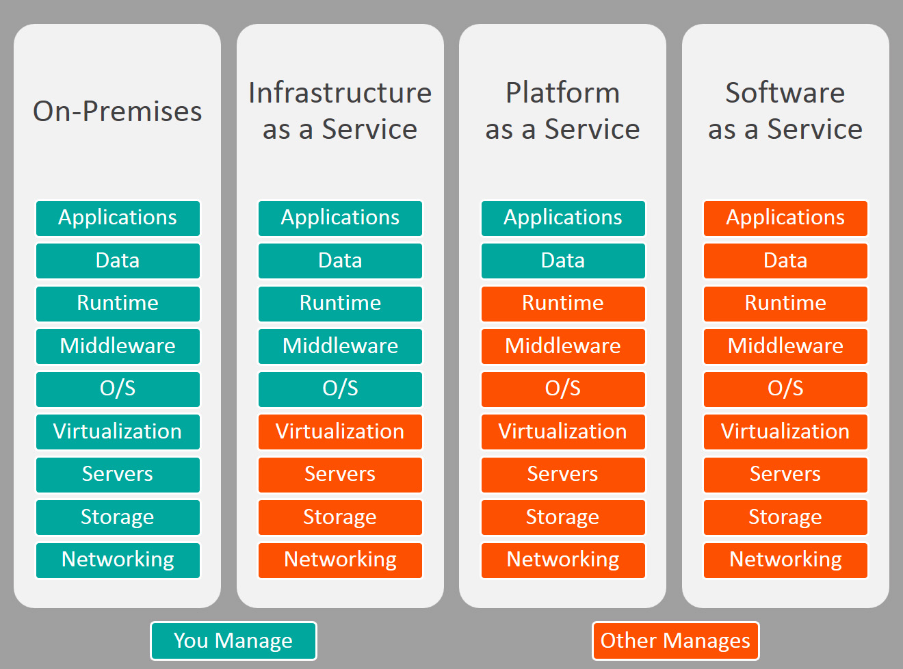
Day 4 | My takeaways
Topics learnt are:
Cloud computing
Hands on azure portal to create virtual machine
IAAS, PAAS and SAAS
Cloud deployment modes – private, public and hybrid
Azure active directory types – CAM, SSO and MFA
Load balancer and virtual networks

Slide 8
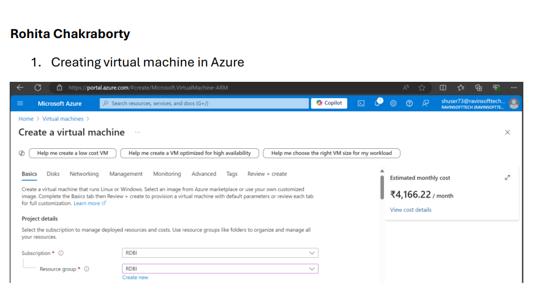
Day 5 | My takeaways
Case study was performed individually on the following topics:
Creating virtual machine in azure portal and performing all the tasks in the same virtual machine and documenting it
Performing software testing on a given website and using agile to create sprint, user stories, test cases, tasks and bugs in azure devops portal.
Implementing CICD pipeline using github actions

Slide 9

Relevance of learnings for my organization

Slide 10
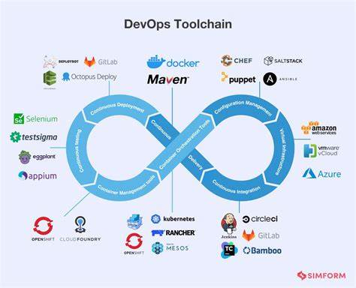
Learning 1 | Relevance for Shell
Learning Azure DevOps can be highly relevant and beneficial in the energy sector for several reasons:
Enhanced collaboration and efficiency
Automated CICD
Scalability and flexibility
Improved security and compliance
Innovation and optimization
Overall, learning Azure DevOps can empower professionals in the energy sector to drive digital transformation, enhance operational efficiency, and support sustainable energy initiatives.

Slide 11
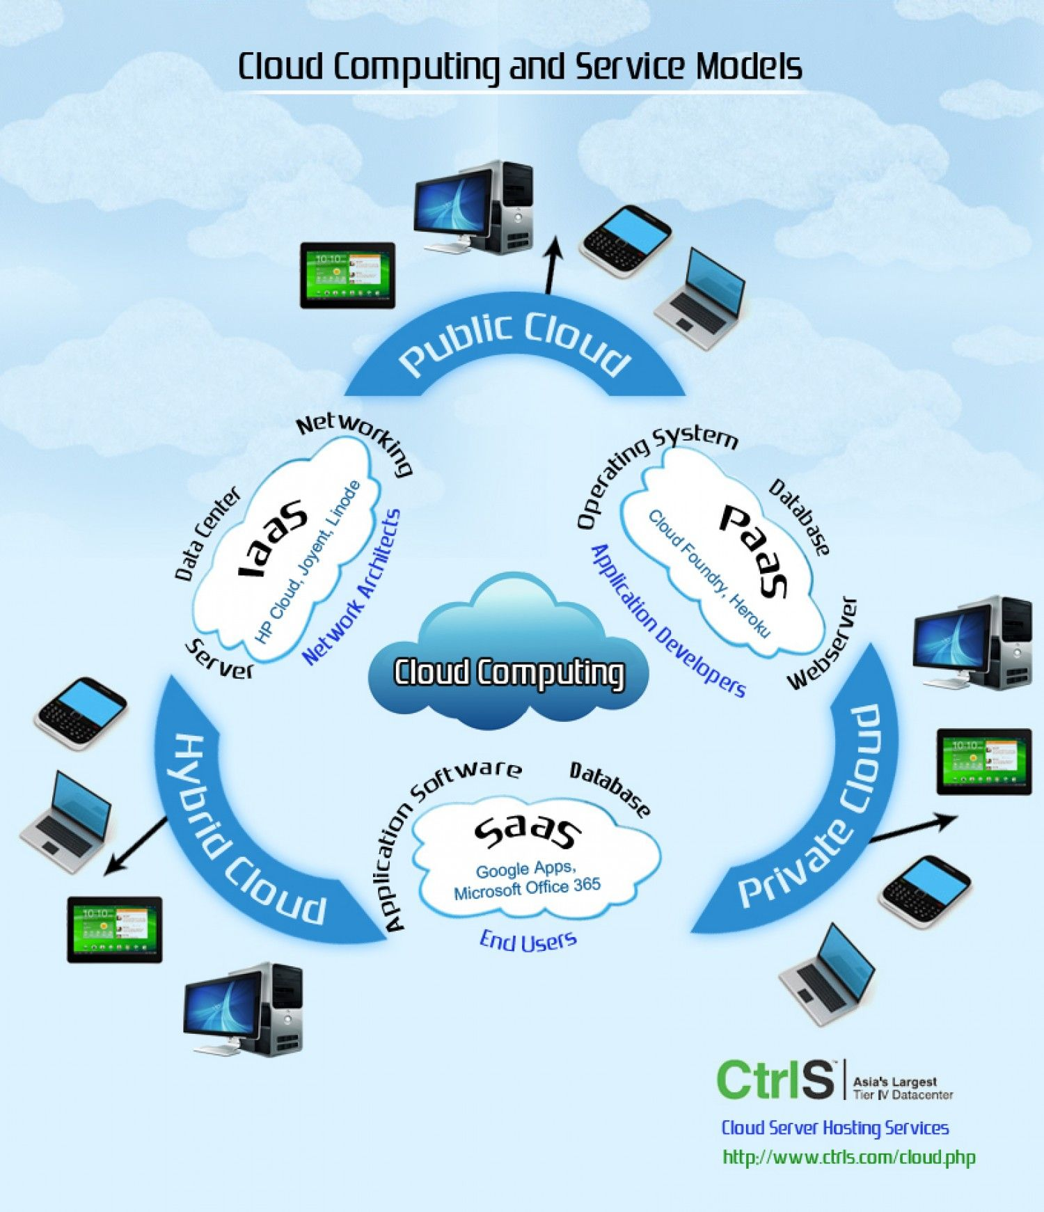
Learning 2 | Relevance for Shell
Cloud computing is transforming the energy sector in several impactful ways:
Enhanced data management
Cost efficiency
Real time data access
Innovation and sustainability
Overall, cloud computing helps energy companies become more agile, resilient, and competitive, while also supporting sustainability initiatives.

Slide 12
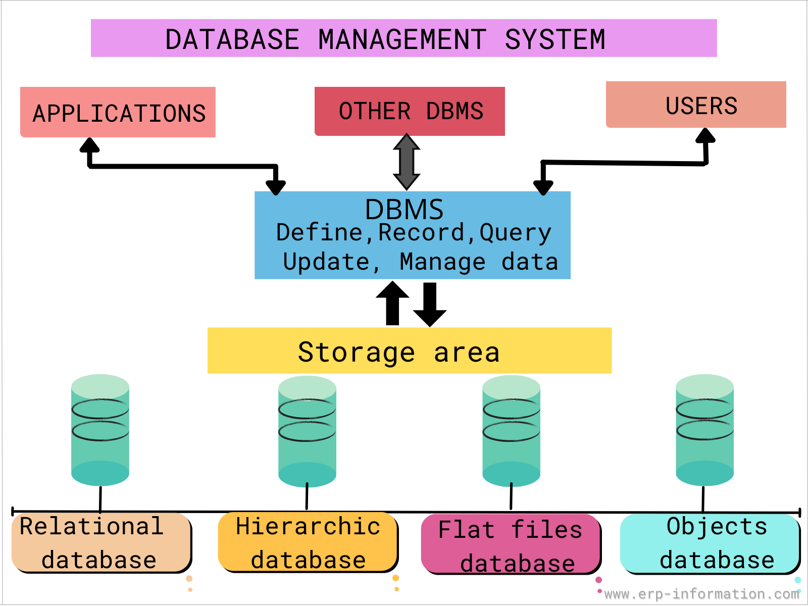
Learning 3 | Relevance for Shell
Database Management Systems (DBMS) play a crucial role in the energy sector for several reasons:
Efficient data handling
Real time monitoring and control
Enhanced decision making
Improved operational efficiency
Security and data integrity
Overall, a DBMS is integral to the digital transformation of the energy sector, enabling better data management, operational efficiency, and strategic decision-making.

Slide 13

Challenges in implementing learning

Slide 14
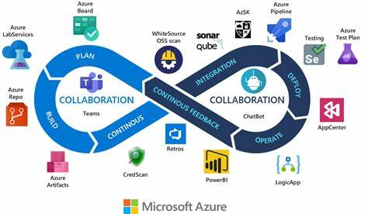
Challenge faced while implementing Learning 1
Implementing Azure DevOps as a fresher can be quite challenging, but it’s also a great learning opportunity. As a fresher, I did not have much hands-on experience with DevOps practices and tools. Grasping the fundamental concepts of DevOps, such as CI/CD, Infrastructure as Code (IaC), and automated testing, can be overwhelming but focusing on learning one concept at a time really helped us.

Slide 15
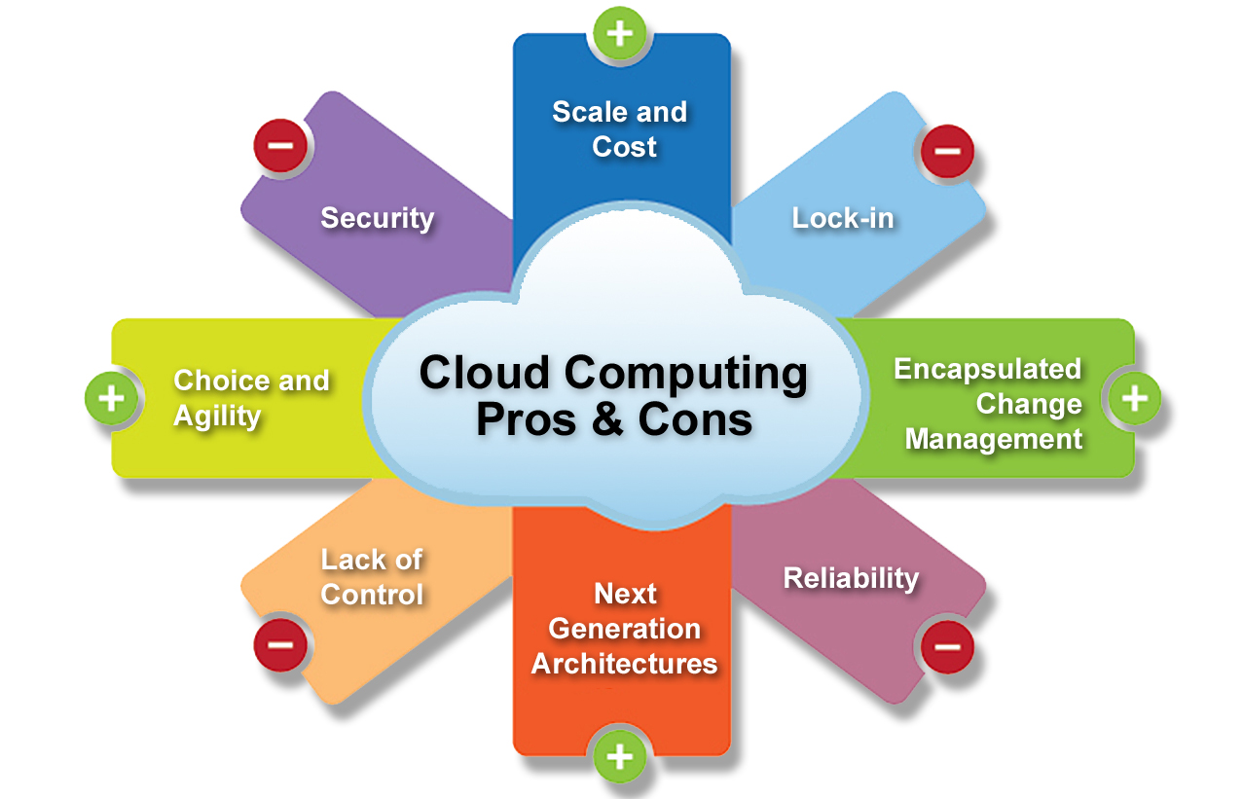
Challenge faced while implementing Learning 2
Ensuring security in the cloud can be complex, especially with the increased attack surface. Managing costs effectively can be challenging, especially as I am not familiar with how cloud billing. Integrating cloud solutions with existing on-premises systems can be complex. Learning about hybrid cloud architectures and using integration tools and services offered by cloud providers was very interesting.

Slide 16
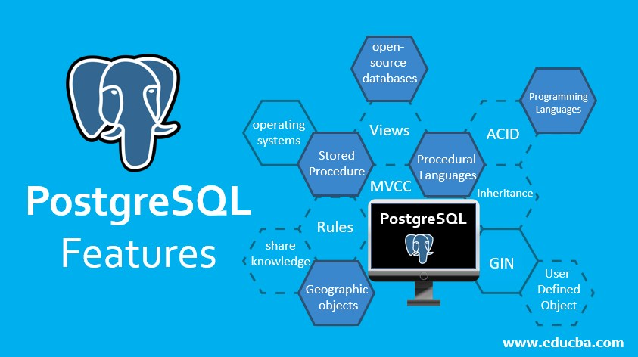
Challenge faced while implementing Learning 3
Learning to write efficient SQL queries is essential but can be challenging. Ensuring the database performs well under load can be difficult. Learning about indexing, query optimization, and performance tuning. PostgreSQL has extensive documentation on these topics. Implementing proper security measures to protect our data can be complex.

Slide 17

Action Plan

Slide 18
My Action Plan for this Week
Actions
Timeline
Status
Need to study all the materials provided to us about devops, agile, dbms, cloud and learn about all the technologies that we will be learning in the bootcamp.
In the weekend, I will be revising and practice the applications to know more about them.
I hope I finish all my work and learn new things which I can apply to my work here.

Slide 19

Learning is also Fun!

Slide 20
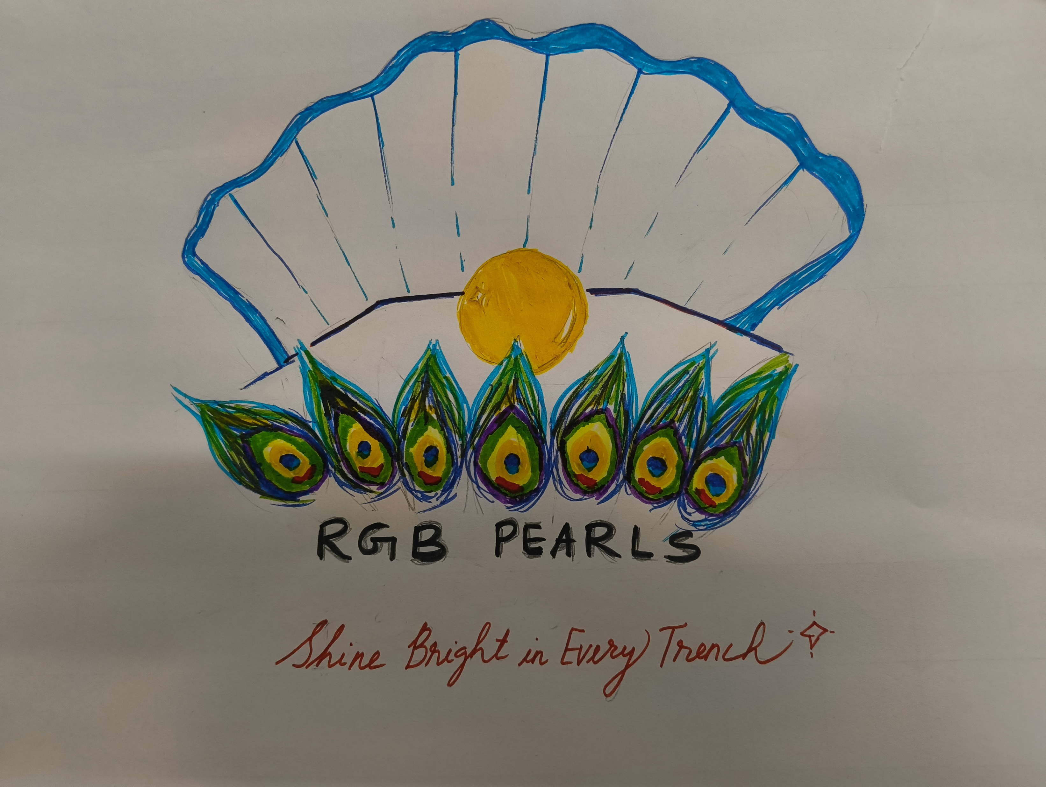
Learning is also Fun!
The entire experience was unique and fun, we got to learn a variety of new topics both theoretically and practically. We also bonded on the group activities that we performed in both the weeks.

Slide 21

Summary
Github link - rohita-ch/Bootcamp (github.com)
Azure Devops
Agile and Scrum
Github actions
Postgresql and DBMS

Slide 22
Thank You

